Slide 1
Walmart sales analysis

Slide 2
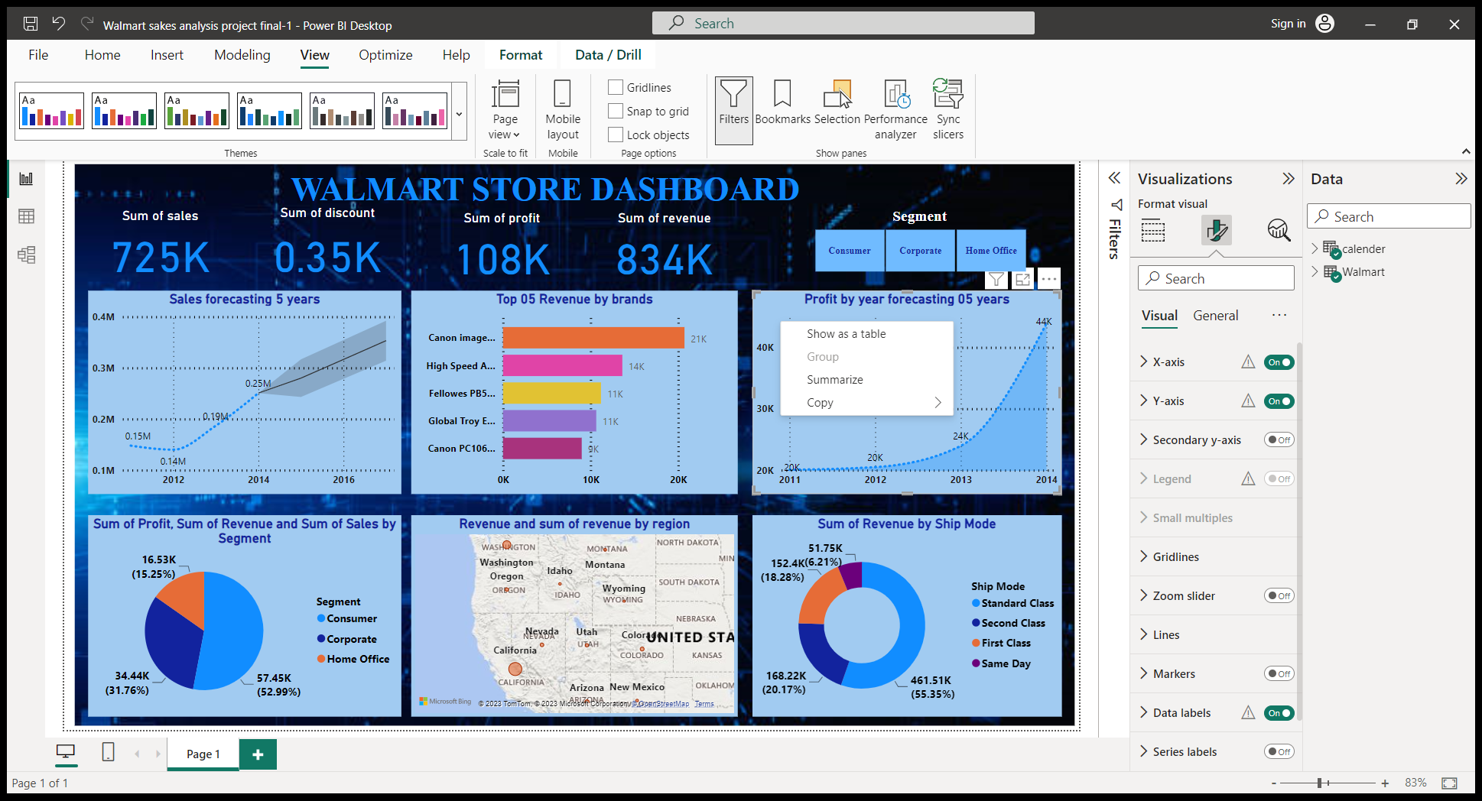
The sales dashboard of walmart

Slide 3
these all are the key components of sales analysis
Sum of sales
Total sales is a key performance indicator (KPI) used by sales department to track the total amount of revenue generated from over a given period of time.
Sum of discount
A discount is an amount subtracted from the normal selling price of a particular commodity.
Sum of profit
The profit that is obtained after deducting the cost of goods sod from its total revenue.
Sum od revenue
The total amount of money that a company earns through the selling of its goods and services, over a time period (a day, week, month or year)

Slide 4
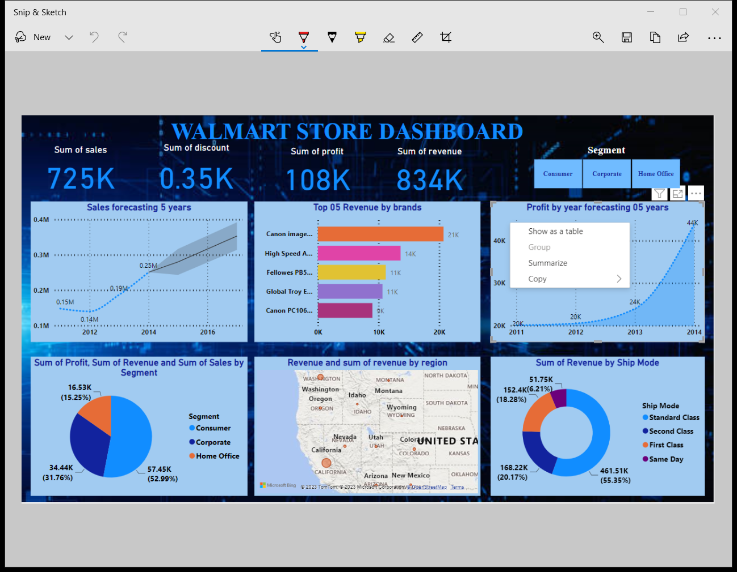
Types of segments
There are three types segments
Consumer
Corporate
Home office

Slide 5
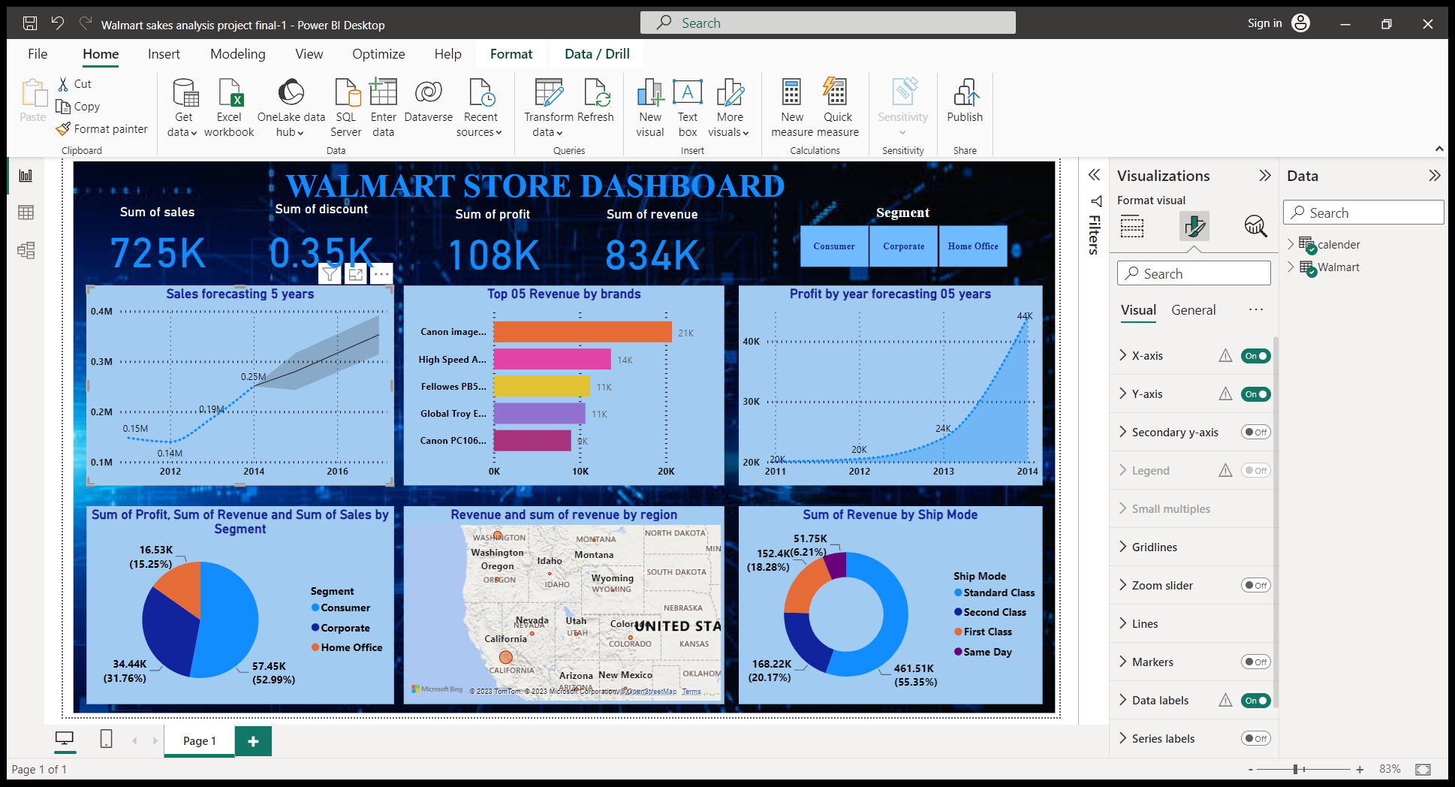
Sales forecasting by 5 years
Sales forecast are predictions of how many products a business will sell in the future , based on data such previous sales
This visual is predict 5 years of sales forecasting

Slide 6
Top 5 revenue by brands
The value a company gains from a product with a recognizable and admired name when compared to a generic equivalent
There are top 5 revenue by brands
Canon image
High speed
Fellowes pb5
Global troy
Canon pc106

Slide 7
Profit by year forecasting (5 years)
A calculation of company’s possible future profit in 5 years made by sales

Slide 8
Sum of profit, sum of revenue and sum of sales by segment
Total number of profits , total number of revenue and total sales by segment in pie chart view

Slide 9
Sum of revenue by region
Total incomes earn by the region

Slide 10
Sum of revenue by ship mode
This table calculate the total revenue by ship mode
There four type of ship mode
Standard class -461.51k
Second class -168.22k
Frist class -152.4k
Same day -51.75k

